Slide 1
I399 Web Design
Lab 2

Slide 2
Project 2 Demo - Where we left off!
We created a new PROJECT FOLDER based on our TEMPLATE…
Added our project RESOURCES...
Marked up our HTML...
Defined basic general and typographic styles in the CSS...
BUT WE DIDN’T REPLACE ANY SPECIAL HTML CHARACTERS!!!
Let’s go back and do that now.
Notes:
AIs

Slide 3
Carefully replace special characters
For the recipe we have, the only characters we will replace are fractions:
One-quarter ¼ &frac14; One-half ½ &frac12; Three-quarters ¾ &frac34; One-third ⅓ &#8531; Two-thirds ⅔ &#8532;
Not sure why there isn’t an easier to remember code for ⅓ and ⅔. Most common symbols have a code as well as other ways to reference these ascii characters.
Multiple methods: All of these will make an ampersand in your text:
&#38; &#x26; &amp;
Notes:
AIs

Slide 4
2A. Style the table
Making a third typeface choice to use for graphical elements
Let’s work down the page, element by element…
table { font-family: "Lucida Sans Unicode", "Lucida Grande", Sans-Serif; font-size: 14px; width: 90%; ← Suck in the content text-align: left; ← Aligns text to left.. Other options ‘right’ and ‘center’ border-collapse: collapse; ← Keeps table cells from having a double border border: 1px solid #6699cc; ← Puts a blue border around the entire thing margin: 40px auto 0; ← Pushes table down a bit, centers it within the container }
Default font is around 16px, but the table will look a little better if I reduce the font size a bit.
Notes:
AIs
Type in as above, then play with the options.
Also comment / uncomment to see what each style does

Slide 5
2B. Style the table
Styling <table> only gets us the box around the table elements.. We need to style the insides as well. Let’s start with the table header.
th { font-weight: normal; ← Default for <th> is bold.. I decided I liked it better not bold. Up to you! color: #003399; ← Make the color of the TEXT blue border-bottom: 1px dashed #6699cc; ← Add a border to the bottom of each <th> padding: 12px 17px; ← Add 12px of space to top & bottom, 17px of space on right & left background: #e8edff; ← Make the table headers stand out with a background /* text-align: right; */ ← Uncomment to see what happens.. You might like it this way! }
Border shortcut.. Style the line width, line style, and line color all at once!
Notes:
AIs
Type in as above, then play with the options.
Also comment / uncomment to see what each style does

Slide 6
2C. Style the table
Now for the table data (the cells).
td { color: #669; ← Make the color of the TEXT blue to match the <th> padding: 12px 17px; ← Same padding as on <th> border-bottom: 1px dashed #69c; ← Same border as on <th> }
CHALLENGE: Could you rewrite these styles to use less lines? How would you do so?
>>> See the FINAL version of Project 2 Demo for an example.
Notes:
AIs
Type in as above, then play with the options.
Also comment / uncomment to see what each style does

Slide 7
How did I know what to type?
Part of it is experience.. I know what parts I want to style. Be patient. You will be able to make those decisions once you practice a little more.
Some of it is trial and error. I make an educated guess, and if it doesn’t look right, I adjust.
And some of it is getting really good at looking up options:
Bookmark these CSS references:
http://cssreference.io/ http://www.w3schools.com/cssref/https://developer.mozilla.org/en-US/docs/Web/CSS/Reference

Slide 8
3A. Style the <h3>
The h2s and lists are already styled.. Let’s skip to the bottom to “Related Articles”.
Under “Typography,” first add some general styles for all h3 tags we encounter.
h3 { font-size: 24px; ← Make the font size more in proportion to our h1 and h2 choices }
Notes:
AIs
Type in as above, then play with the options.
Also comment / uncomment to see what each style does

Slide 9
3B. Style the <h3>
This h3 really is sort of a footer for us.. It ends the page. Let’s make it move away from the main content and add a line on top. Make it look like related content!
HTML <h3 class=”related”>Related Articles</h3> ← Add a class
CSS .related { border: 1px solid black; ← Add a style that matches our special class on the h3 }
Notes:
AIs
Type in as above, then play with the options.
Also comment / uncomment to see what each style does

Slide 10
3B. Style the <h3>
CSS .related { border-top: 1px solid black; ← Let’s try making the border only show up on the top }
This is better, but the h3 text is a little too close to the border. Sometimes that might be a style choice you make, but I think for this design, the extra space will look better. Also, Related Articles is a separate element from the main content.. Let’s add some space on the top of the line to move it away from that content.
Notes:
AIs
Type in as above, then play with the options.
Also comment / uncomment to see what each style does

Slide 11
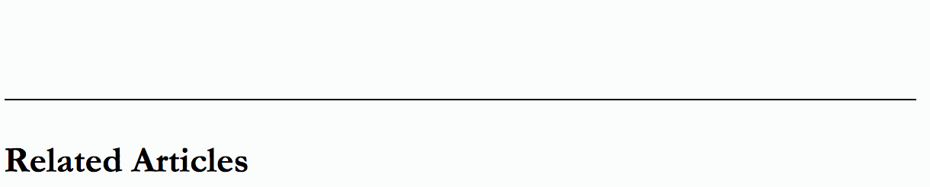
3B. Style the <h3>
CSS .related { border-top: 1px solid black; margin-top: 4.0em; ← Add space between the line and the main recipe content padding-top: 1.0em; ← Add space inside the h3 to push the edge away from the content }
Notes:
AIs
Type in as above, then play with the options.
Also comment / uncomment to see what each style does

Slide 12
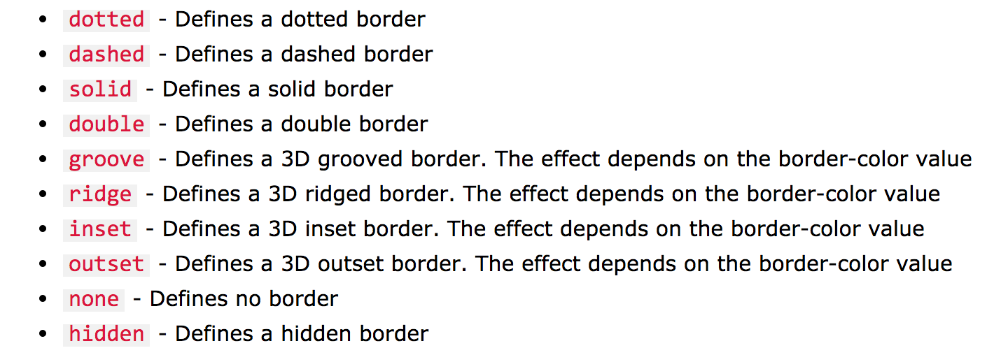
3B. Style the <h3>
So something fun we can do is mess with the border styles: http://www.w3schools.com/css/css_border.asp
.related { border-top: 1px dotted black; ← The middle value represents border-style margin-top: 4.0em; padding-top: 1.0em; }
Change the border style (and width and color if you’d like to) and see what happens!
Notes:
AIs
Type in as above, then play with the options.
Also comment / uncomment to see what each style does

Slide 13
4. Adjust your color choices
In our current page, we set color on three kinds of elements.. Feel free to play with those to get a look you like.
background-color: #CB4335; ← Sets the background of the page to a red/orange color
color: #666699; ← Makes the text in our table a dark blue
border-top: 1px dotted black; ← Makes a black border
We’ll spend a lot of time on color soon, but for now, any of these named colors will work! http://www.w3schools.com/colors/colors_names.asp
Notes:
AIs
Type in as above, then play with the options.
Also comment / uncomment to see what each style does

Slide 14
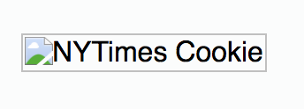
5. Add images
Add an image to your page. We’ve provided five options. Choose one.
<div class="container"> <img src="nytimes-cookie.jpg" alt="NYTimes Cookie"> <h1>
>>> Did it load? What happened instead? Where did that label come from?
Notes:
AIs
Type in as above, then play with the options.
Also comment / uncomment to see what each style does

Slide 15
5. Add images
We have to tell our index.html page where the image is located. It can ONLY SEE what is in the project folder at its level. We need to say “go into the assets folder, then the images folder, and look for our cookie picture”.
<div class="container"> <img src="assets/images/nytimes-cookie.jpg" alt="NYTimes Cookie"> <h1>
The / (forward slash) represents a directory or folder. So we’re literally saying inside the assets folder, then the images folder, that’s where our image lives.
Notes:
AIs
Type in as above, then play with the options.
Also comment / uncomment to see what each style does

Slide 16
5. Add images
Depending on what image you selected.. It’s either a little too small or too big.
Images are BAD BAD BAD at listening. This is partially due to their default setting of inline-block. By default, the image doesn’t understand it’s in a container!
img { width: 100%; }
We’ll talk more about this in class, but we just want the image to fill the container we’ve placed it inside. Let’s tell it to have a width of 100%. That will force it to pay attention to the container and it will fill the available space more naturally.
Notes:
AIs
Type in as above, then play with the options.
Also comment / uncomment to see what each style does

Slide 17
Is there more?
YUP! We’ll pick up from here next week.
Please have your AI check you off for the work you finished in lab today.
10 points

